Slide 1
Project Scheduling
Dr. RAJIB MALL
Professor
Department Of Computer Science & Engineering
IIT Kharagpur.

Slide 2
Project Scheduling Activities
Determining Activities
Determining available resources
Identifying precedence relationships
Determining activity times
Determining critical activities
Allocating resources

Slide 3
Basics
Schedule converts action plan into an operating time table…
Basis for monitoring and controlling projects…
“Scheduling more important in projects than in production jobs.”
Let us now discuss a few points:
  Every project manager must remember these during project scheduling.

Slide 4
Project Scheduling Process
Scope statement
Develop a Work Breakdown Structure (WBS) (Scope definition)
Identify precedence relationships
Estimate time needed for each task
Determine resources needed for each task
Draw an activity-on-arrow PERT diagram inserting dummy activities if required.
Part 4 - Project Planning

Slide 5
Project Scheduling Steps
Apply CPM to calculate earliest and latest starting times, earliest and latest completion times, slack times, critical path etc.
Construct a GANTT chart.
Reallocate resources if necessary.
Continuously monitor/revise the time estimates along the project duration.
Notes:
Maria Petridou
University of Nottingham

Slide 6
Work breakdown structure (WBS)
Hierarchical decomposition of a project into subtasks
  Shows how tasks are decomposed into subtasks
  Does not show duration
  Does not show precedence relations (e.g. task A must be finished before task B can start)
Project
Design
Test plan
Code
Test
Code A
Code B

Slide 7
WBS Example
Level 1
ABC Project
Level 2
Definition
Analysis
Design
Programming
...
Level 3
Requirements
Documentation
Feasibility
Study
Risk Analysis
...

Slide 8
A Task Network
Also called an Activity Network
Depict task flow for a project
  Task length, sequence, concurrency, and dependency
  Represent inter-task dependencies
The critical path:
  A single path leading from start to finish in a task network
  Contains the sequence of tasks that must be completed on schedule, if the project as a whole is to be completed on schedule
  Also determines the minimum duration of the project

Slide 9
Example Task Network
Task F
2
Task G
3
Task H
5
Task B
3
Task N
2
Task A
3
Task C
7
Task E
8
Task I
4
Task J
5
Task M
0
Task D
5
Task K
3
Task L
10
Where is the critical path and what tasks are on it?
Is it possible to have two critical paths?

Slide 10
Example Task Network with Critical Path Marked
Task F
2
Task G
3
Task H
5
Task B
3
Task N
2
Task A
3
Task C
7
Task E
8
Task I
4
Task J
5
Task M
0
Task D
5
Task K
3
Task L
10
Critical path: A-B-C-E-K-L-M-N

Slide 11
PERT & CPM
Both task Network-based techniques
Developed in 1950’s
  CPM by DuPont for chemical plants
  PERT by U.S. Navy for Polaris missile
Consider precedence relationships & interdependencies
Each uses a different estimate of activity times

Slide 12
PERT (Program Evaluation and Review Technique)
Test plan 10
Design 15
Code A 18
Test 15
Code B 18
A network (graph) where the nodes represent tasks and arrows describe precedence relations
  Used successfully in management of Polaris missile project in 50’s
  Shows probabilistic task durations (on the task node)

Slide 13
PERT Chart
Actually a derivative of the GANTT chart
Multiple time estimates were used for each task:
  Allowed for variations due to uncertainty in determined activity times
  Activity times are assumed to be random, with certain assumed probability distribution
PERT originally was an activity on arc network:
  Over time, people began to use PERT as an activity on node network.

Slide 14
Probabilistic Time Estimates
PERT-type approach uses 3 time estimates for each activity
Most likely time (m)
  subjective estimate of most frequent time
Optimistic time (a)
  shortest possible time (ideally)
Pessimistic time (b)
  longest time possible if everything went wrong

Slide 15
CPM
Developed to coordinate maintenance projects in the chemical industry:
  A complex undertaking, but individual tasks are routine (tasks’ duration = deterministic)
  Did not allow for variation in activity times
  Activities are represented as nodes or circles
  Allowed controlling project duration through identification of critical path

Slide 16
Both PERT and CPM
Graphically display the precedence relationships & sequence of activities
Estimate the project’s duration
Identify critical activities:
  Activitiesthat cannot be delayed without delaying the project
Estimate the amount of slack associated with non-critical activities

Slide 17
Comparison Between CPM and PERT
 | CPM | PERT
1 | Uses network, calculate float or slack, identify critical path and activities, guides to monitor and controlling project | Same as CPM
2 | Uses one value of activity time | Requires 3 estimates of activity time Calculates mean and variance of time
3 | Used where times can be estimated with confidence, familiar activities | Used where times cannot be estimated with confidence. Unfamiliar or new activities
4 | Minimizing cost is more important | Meeting time target or estimating percent completion is more important
5 | Example: construction projects, building one off machines, ships, etc | Example: Involving new activities or products, research and development etc

Slide 18
CPM/PERT
Over time, CPM and PERT merged into one technique:
  referred to as "CPM/PERT".
Visually easier to see precedence relationships
Ideal for large projects with many activities
  Consist of a network of branches and nodes

Slide 19
Sample Usage of PERT & CPM
Completion date?
On schedule? Within budget?
Probability of completing by ...?
Critical activities?
Enough resources available?
How can the project be finished early at the least cost?

Slide 20
PERT & CPM Steps
Identify activities
Determine sequence
Create network
Determine activity times
Find critical path:
  Earliest & latest start times
  Earliest & latest finish times
  Slack

Slide 21
Example PERT Diagram
3
B
D
A
F
1
2
5
6
C
E
4
Single finish
node
Single start
node
Notes:
Maria Petridou
University of Nottingham

Slide 22
Some Network Definitions
All activities on the critical path have zero slack
Slack defines how long non-critical activities can be delayed without delaying the project
Slack = the activity’s late finish minus its early finish (or its late start minus its early start)
Earliest Start (ES) = the earliest finish of the immediately preceding activity
Earliest Finish (EF) = is the ES plus the activity time
Latest Start (LS) and Latest Finish (LF) = the latest an activity can start (LS) or finish (LF) without delaying the project completion

Slide 23
Earliest start & earliest finish time
We are interested in the critical path = longest path through the network.
Starting at the network’s origin (node 1) and using a starting time of 0,
  Compute an earliest start (ES) and earliest finish (EF) time for each activity in the network.
The expression EF = ES + t can be used to find the earliest finish time for a given activity.
For example, for activity A, ES = 0 and t = 5; thus the earliest finish time for activity A is
EF = 0 + 5 = 5

Slide 24
Example: Slack or Float
earliest start = day 5
latest finish = day 30
duration = 10 days
earliest finish =?
latest start = ?
Float = LF - ES - duration
What is float it in this case?
Notes:
The earliest finish (EF) would be day 5 plus 10 days i.e. day 15.
The latest start (LS) would be day 30 – 10 days i.e. day 20
The float would be 30 – 5 – 10 = 15 days
This also is the same as LF – EF or LS - ES

Slide 25
Critical Path Analysis
Provides activity information
  Earliest (ES) & latest (LS) start
  Earliest (EF) & latest (LF) finish
  Slack (S): Allowable delay
Identifies critical path
  Longest path in network
  Shortest time project can be completed
  Any delay on activities delays project
  Activities have 0 slack

Slide 26
BENEFITS OF CPM / PERT NETWORK
Consistent framework for planning, scheduling, monitoring, and controlling project.
  Shows interdependence of all tasks, work packages, and work units
  Helps proper communications between departments and functions.
  Determines expected project completion date.
  Identifies critical activities, which can delay the project completion time.

Slide 27
BENEFITS OF CPM / PERT NETWORK
Identifies activities with slacks :
  These can be delayed for specified periods without penalty, or from which resources may be temporarily borrowed
Determines the dates on which tasks may be started or must be started:
  if the project is to stay in schedule.
Shows which tasks must be coordinated to avoid resource or timing conflicts.
Shows which tasks may run in parallel to meet project completion date

Slide 28
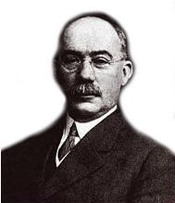
GANTT charts
Named after Henry Gantt (1861 - 1919) an American mathematical engineer.

Slide 29
GANTT charts
A Gantt chart is a type of bar chart:
  Captures start and finish dates of the activities
Elements of a GANTT chart:
  Task names
  Start and finish dates of each tasks (graphically)
  Dependency relationships
  Task duration in an additional column
  Name of the project worker responsible for the task or Resource specifications
  other

Slide 30
Gantt Chart
Characteristics:
  The bar in each row identifies the corresponding task
  The horizontal position of the bar identifies start and end times of the task
  Bar length represents the duration of the task
  Task durations can be compared easily
  Good for allocating resources and re-scheduling
  Precedence relationships can be represented using arrows
  Critical activities are usually highlighted
  Slack times are represented using bars with doted lines
  Bar of each activity begins at the activity earliest start time (ES)
  The bar of each activity ends at the activity latest finish time (LF).
Notes:
Maria Petridou
University of Nottingham

Slide 31
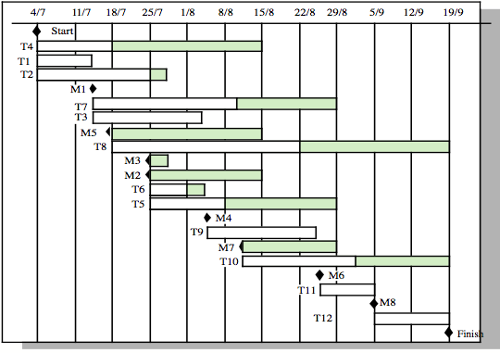
Gantt Chart: Activity Timeline
Planned completion
Latest completion
Notes:
Ch 4

Slide 32
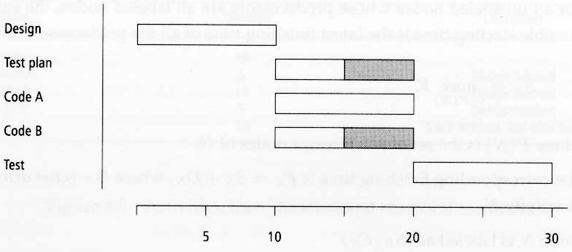
Gantt charts
A graphical visualization of a schedule, where the time span for each activity is depicted by the length of a segment drawn on an adjacent calendar
  Generally does not show task decomposition
  Does not show duration, only the time span over which the task is scheduled
  Can show activity of multiple developers in parallel
  Makes it easy to monitor a project’s progress and expenditures

Slide 33
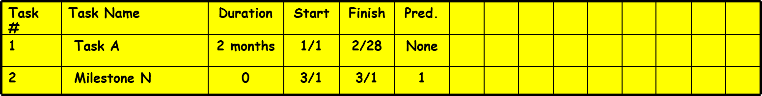
Gantt Chart
Horizontal bar on the calendar indicates duration of the task
  Multiple bars occurring at the same time interval on the calendar, implies task concurrency
  A diamond in the calendar area of a specific task indicates that the task is a milestone; a milestone has a time duration of zero
Jan Feb Mar Apr May Jun Jul Aug Sep

Slide 34
Limitations
Can become quite unwieldy for projects with too many activities.
Projects are often too complex for a Gantt chart.
Gantt charts represent only a part of the project constraints.

Slide 35
Benefits of the GANTT chart
Easy to read and comprehend
Easy to create
Identify the project network coupled with its schedule baseline
Supports updating and project control
Useful for resource planning

Slide 36
Conclusion
Outlined what a project is
Summarized the 3 main project management activities
Drew project networks
Compared PERT & CPM
Determined slack & critical path
Computed project probabilities

